Slide 1
Classification: Bank Customer Churn Analysis
Authors:
STUDENT NAME | REG NUMBER | STUDENT NUMBER
OGWENO WASHINGTON ODHIAMBO | 2024/HD05/21955E | 2400721955
OCHALO DEOGRATIUS | 2023/HD05/20127U | 2300720127
Presented by – Washington & Deogratius
Affiliation: Makerere University
Uganda

Slide 2
1.0 Background
Retail Banking
Due to technological advancements, changing consumer expectations, and increasing competition, Retail Banking landscape have transformed into comprehensive service providers that offer a wide range of financial products, including checking and savings accounts, loans, mortgages, investment services, and digital banking solutions.
Notes:
The dataset can be found here.

Slide 3
2.0 Introduction
Customer expectations and demand in the dynamic business environment, understanding customer behaviour and preferences has become crucial. Requiring retail banking sectors to leverage on data analytics to gain insights into their customer base and identify distinct segments.
Bank Customer Churn Analysis: is created to analyze potential churn customers within retail bank.
Notes:
The dataset can be found here.

Slide 4
3.0 Literature review
CHURN PREDICTION
Use Studies
Telecommunications
Banking and Finance
E-commerce and Retail
Streaming and Subscription Services
Notes:
The dataset can be found here.

Slide 5
4.0 Gaps, significancy or work
Gaps in Current Research
Limited Focus on Localized Data
Integration of Real-Time Data
Understanding of Customer Segmentation
Churn Prediction Methodologies
Ethical Considerations and Data Privacy

Slide 6
4.0 Gaps, significancy of work
Improved Revenue Optimization
Enhanced Customer Experience
Reduction in Churn Rates
Ethical Frameworks
Enhanced Customer Insights
Competitive Advantage
Improved Predictive Models
Informed Strategy Development
Responsible Data Usage

Slide 7
5.0 Project scope
Predict Customer Churn: Develop a machine learning model or analytical framework to predict which customers are likely to close their accounts or significantly reduce their engagement with the bank.
Enhance Customer Lifetime Value (CLV): By identifying churn rates, the project aims to increase the overall customer lifetime value, thereby positively impacting the bank’s revenue and profitability.

Slide 8
6.0 Problem statement
The goal of this project is to develop a predictive model to identify customers in the retail banking sector who are at high risk of churning

Slide 9
Methodology
1
Data Preparation and Cleaning
Load and Preprocess
3
Churn Analysis
Calculate churn column and Visualise churn distributions
2
Exploratory Data Analysis (EDA)
Visualize distributions and Correlation
4
Predictive Modelling
Split data, train, Test and evaluate models' accuracy
5
Classification Report
Confusion Matrix, classification report, F1 Score etc
6
Report Generation
Summarize findings

Slide 10
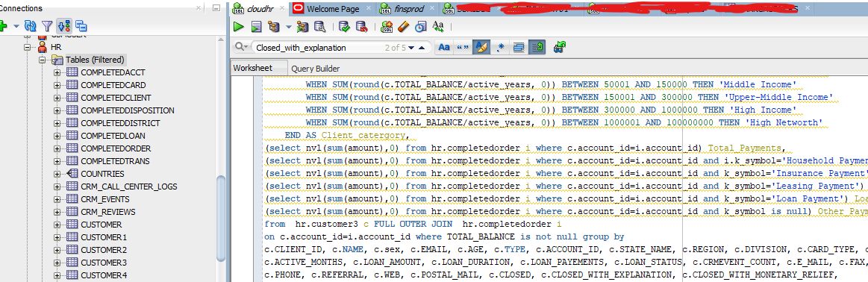
Dataset Description
https://data.world/lpetrocelli/retail-banking-demo-data
URL:
https://www.kaggle.com/datasets/kabure/retail-bankingdemodata?resource=download
https://github.com/rkomartin/bank-data-example/blob/bbc458e2e03076f9d7a923a659273848f1d0cb4d/bank_data/bank-data.csv
https://github.com/madhavappaneni/Retail-Banking-Application/tree/main/preprocessed_datasets
Oracle Database
SQL Query

Slide 11
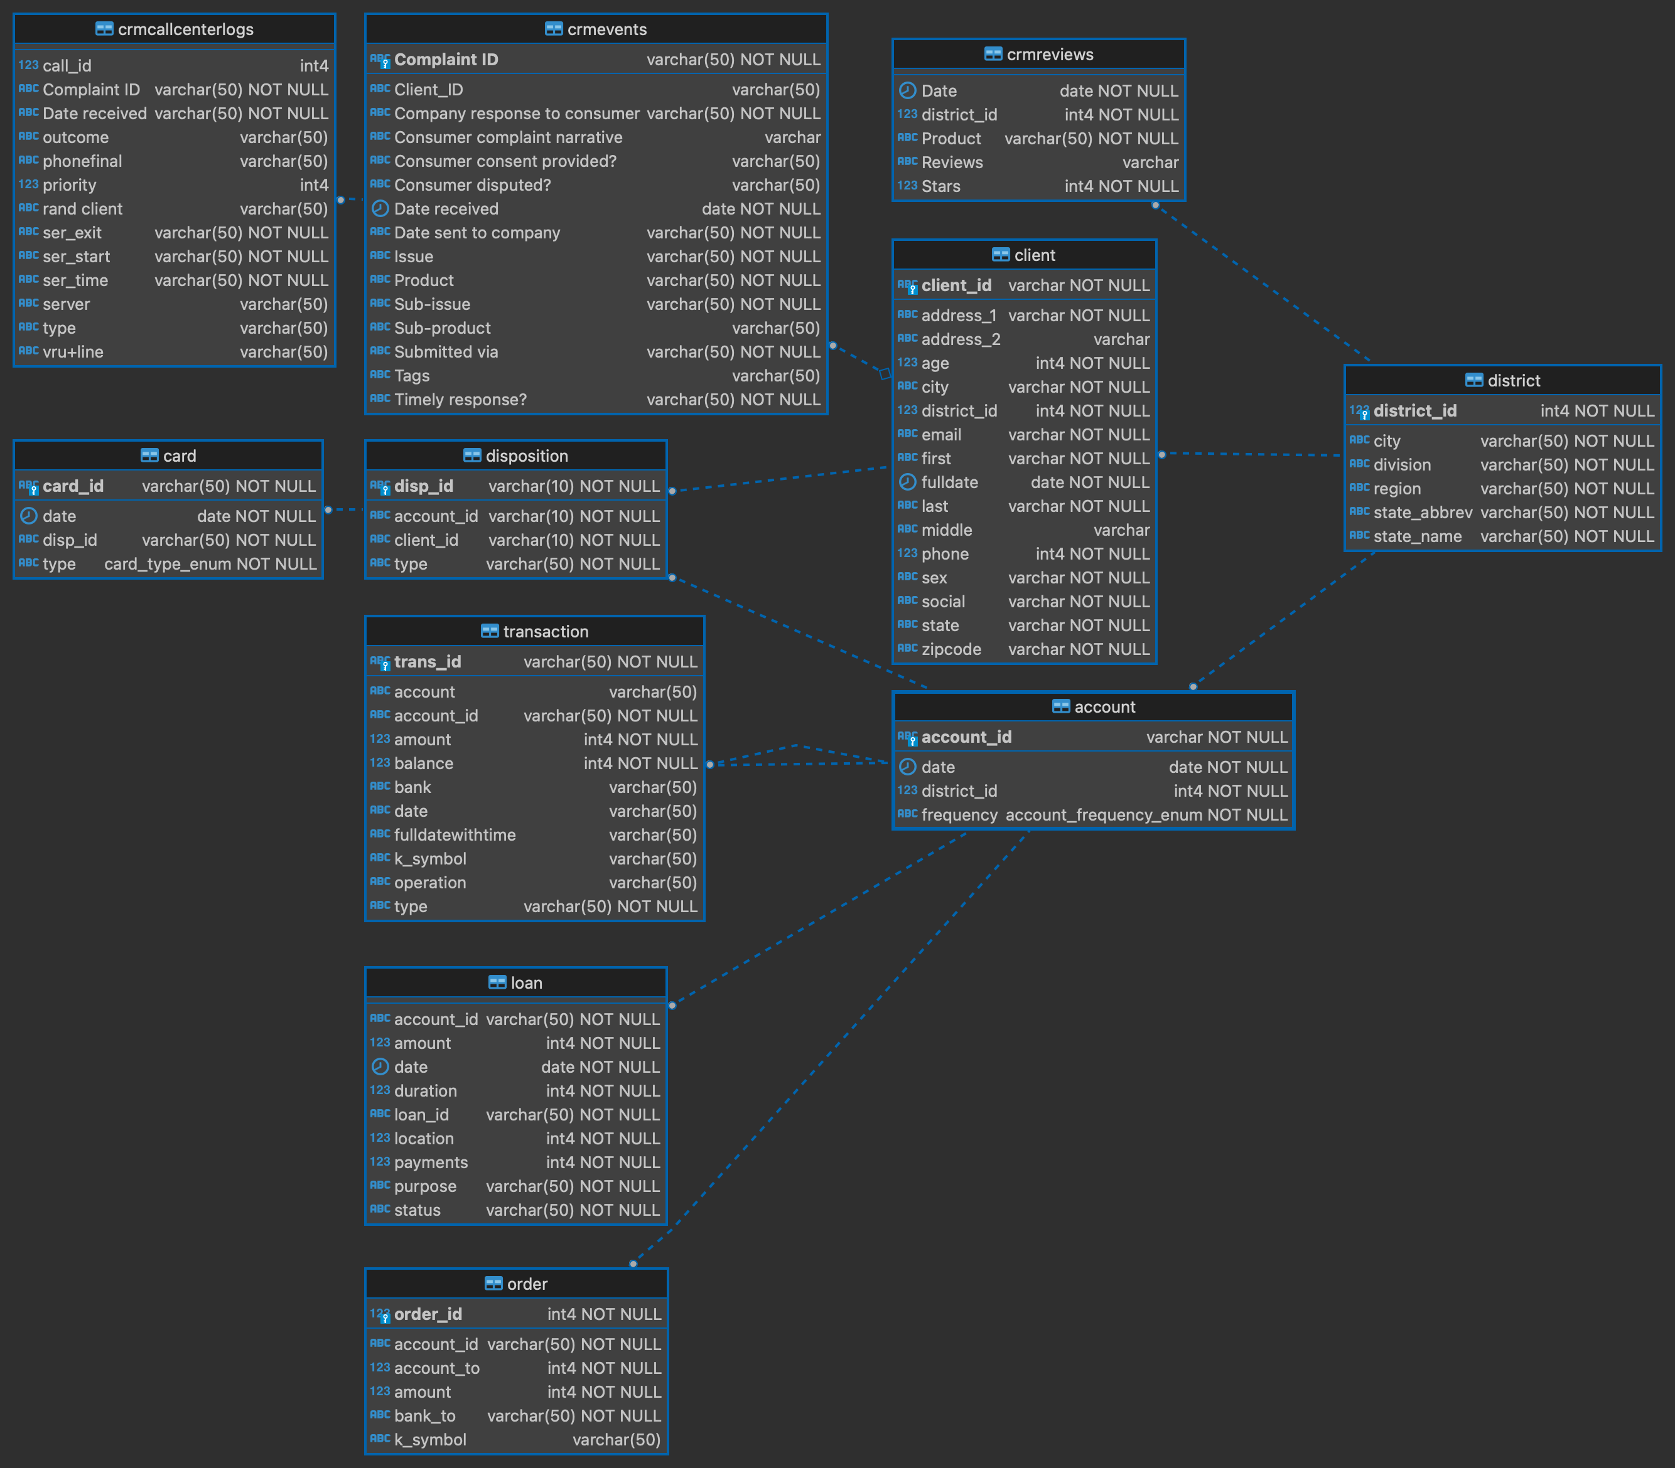
Dataset Description

Slide 12


1. Data Preparation and Cleaning
Data Summary
Total 41 rows, 4708 rows
Data type (objects, int64 & float64)
No null values
No churn Column

Slide 13
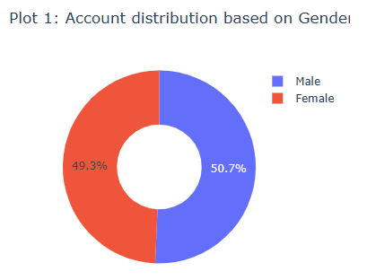
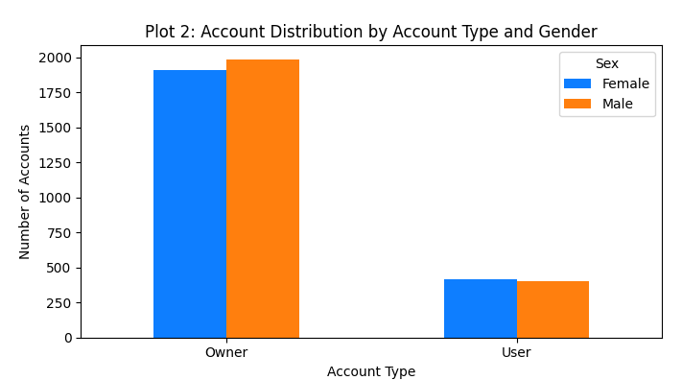
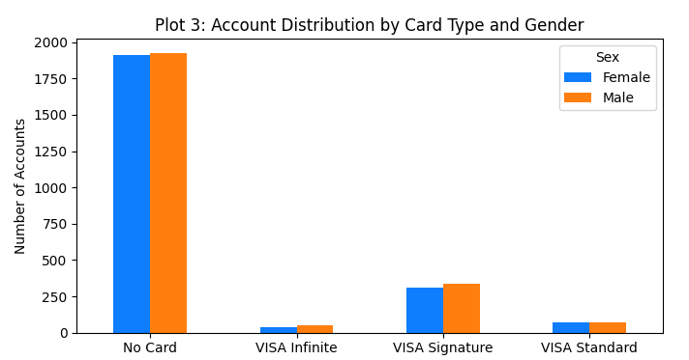
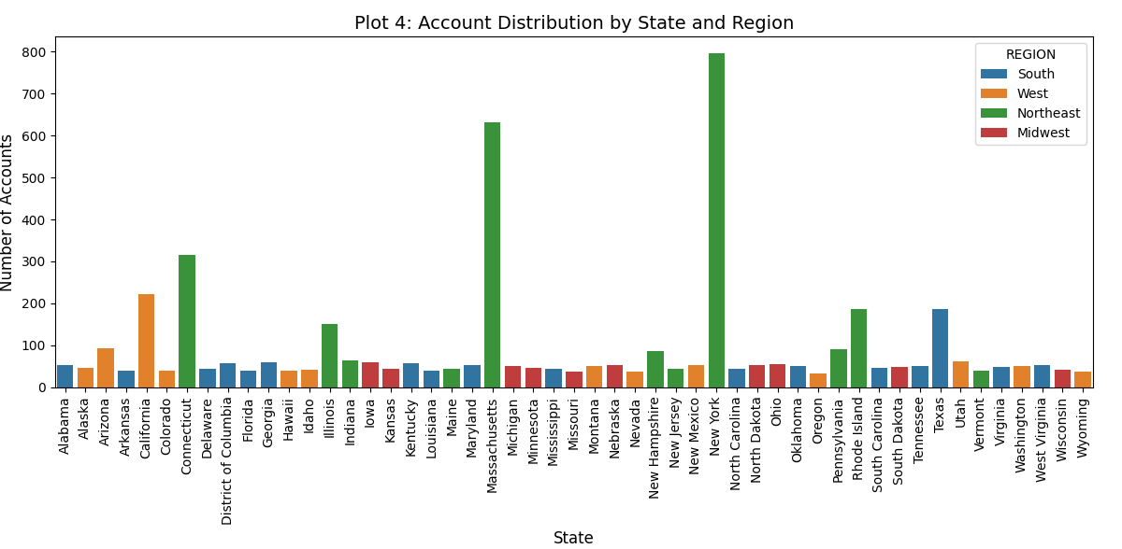
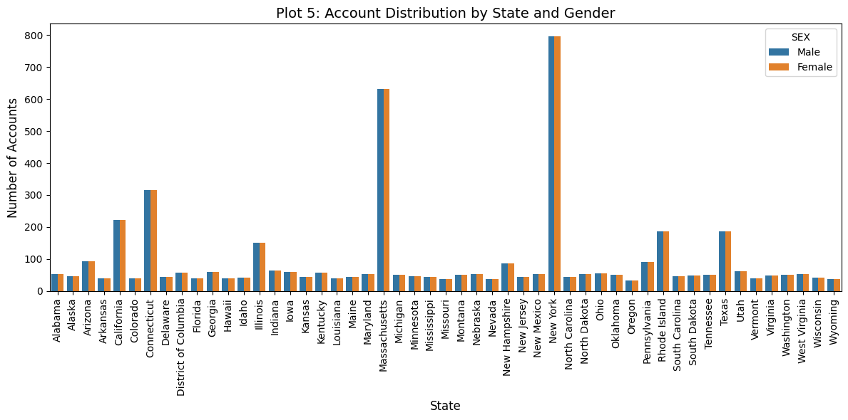
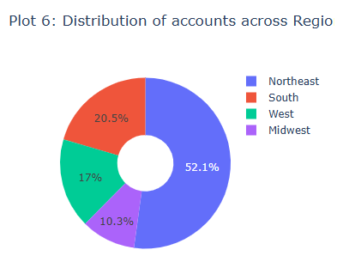
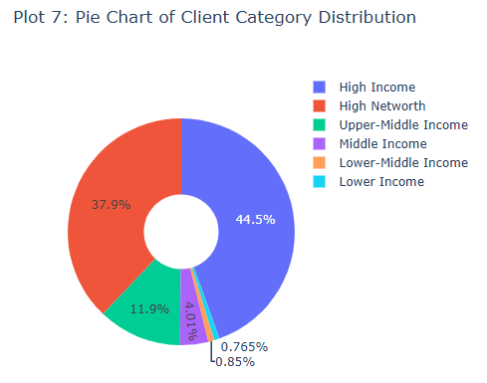
2. Exploratory Data Analysis (EDA)

Slide 14
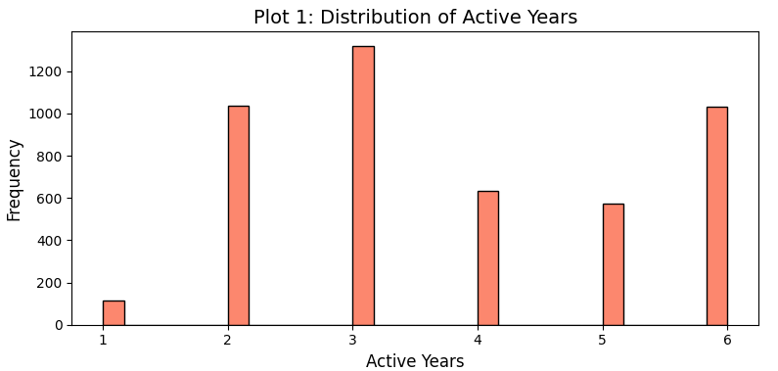
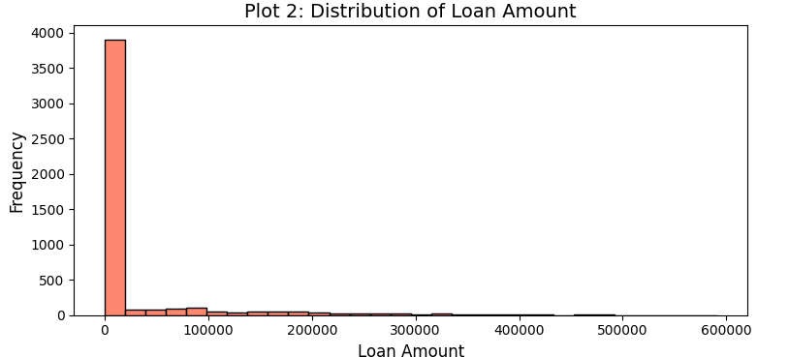
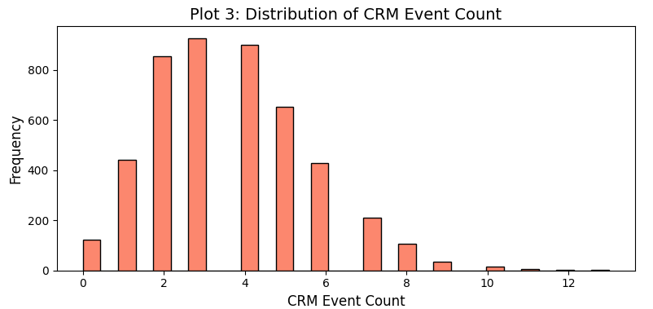
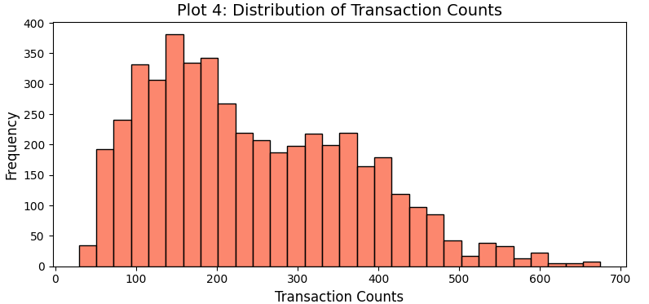
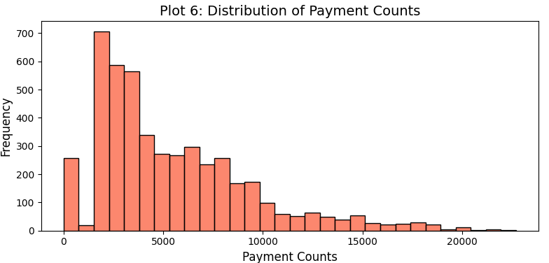
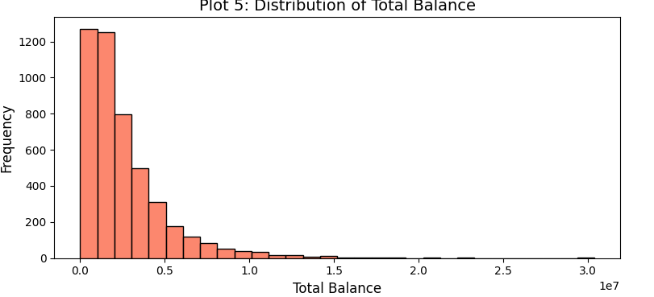
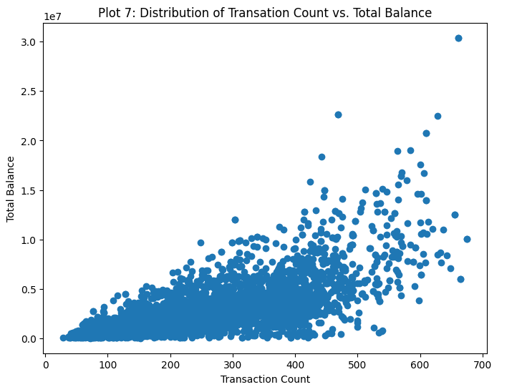
3. Churn Analysis
# ['ACTIVE_YEARS', 'LOAN_AMOUNT', 'CRMEVENT_COUNT', 'TRANS_COUNT', 'TOTAL_BALANCE', 'TOTAL_PAYMENTS']
Summary
Most customers have lower payment activity, with a small proportion showing high, very high activity and balance.

Slide 15
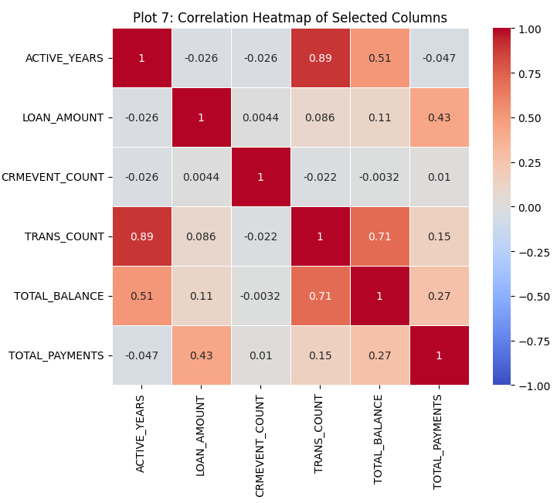
3. Churn Analysis
# ['ACTIVE_YEARS', 'LOAN_AMOUNT', 'CRMEVENT_COUNT', 'TRANS_COUNT', 'TOTAL_BALANCE', 'TOTAL_PAYMENTS']
Strong Positive Correlations
Customers with a higher number of active years tend to have a higher transaction count.
A high transaction count correlates with a higher total balance
Moderate Positive Correlations
Total balance and active years suggest that customers who remain longer tend to accumulate a higher balance
Customers with higher loan amounts tend to make higher total payments.
Weak Positive Correlations
Loan amount doesn’t significantly affect the balance in accounts.
CRM event counts may be independent of other transactional.

Slide 16
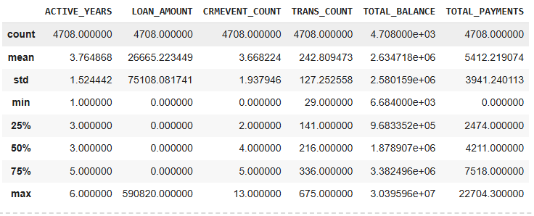
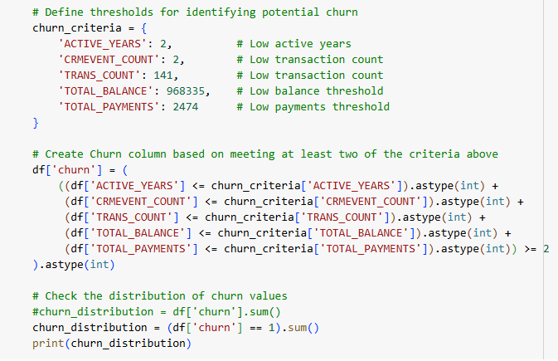
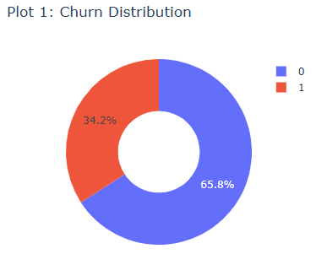
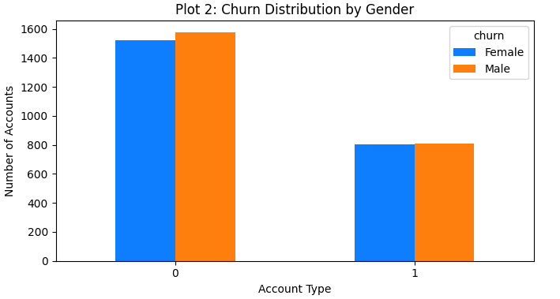

Slide 17
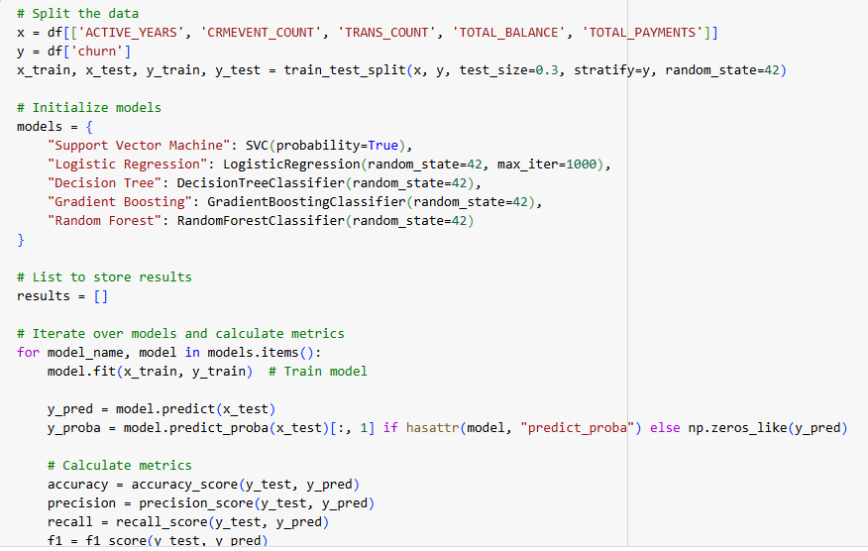
Predictive Modelling
# Split the data & model training
ACTIVE_YEARS', 'CRMEVENT_COUNT', 'TRANS_COUNT', 'TOTAL_BALANCE', 'TOTAL_PAYMENTS'
# Initialize models

Slide 18
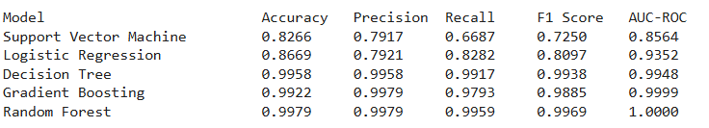
Predictive Modelling
Accuracy:
Proportion of correctly predicted observations (both true positives and true negatives) out of the total observations
Precision:
Measures the accuracy of the positive predictions. It is the ratio of true positive predictions to the total predicted positives.
Recall:
Measures the proportion of actual positives that are correctly identified by the model.
F1 Score:
Is the harmonic mean of precision and recall, providing a single metric that balances both concerns.
AUC-ROC:
Is a performance metric that shows how well the model can distinguish between classes.
Random Forest: Achieved the best metrics across the board, with perfect AUC-ROC and very high Accuracy, Precision, Recall, and F1 Score.

Slide 19
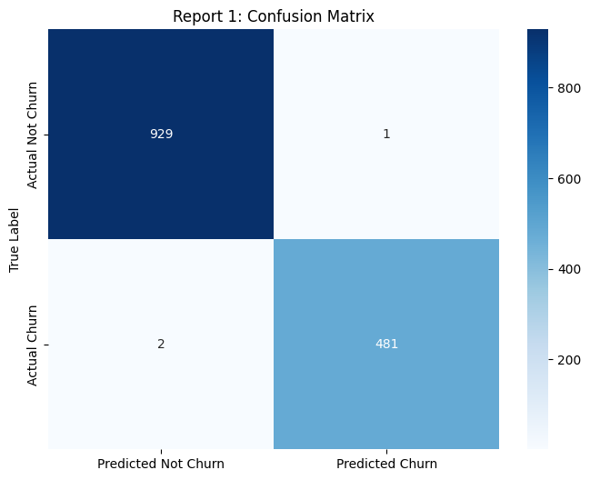
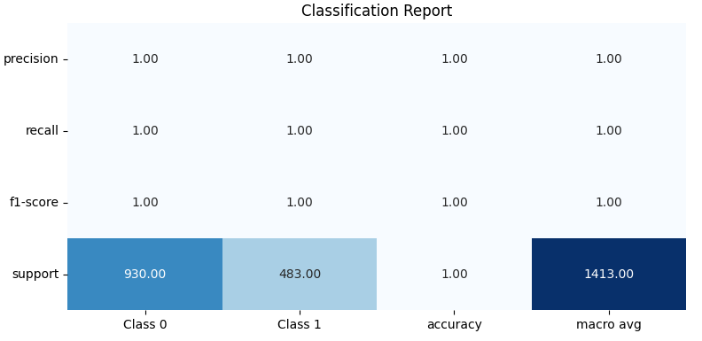
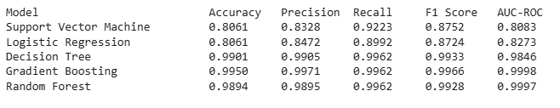
Classification Report
50 % Percentile

Slide 20
Thank You!

